Slide 1


AI-Powered Student Performance Monitoring & Early-Warning System

Slide 2
Problem Statement
The Problem
Academic underperformance detected too late
Evaluation depends on final grades
Many influencing factors ignored
No early warning mechanism

Slide 3
Why Prediction Matters
Why Early Prediction is Important
Early identification of at-risk students
Enables timely academic intervention
Supports personalized guidance
Improves educational outcomes

Slide 4
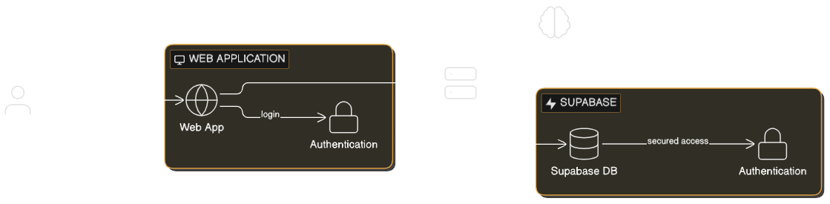
System Architecture
System Architecture Overview
User → Web Application → Backend API → Machine Learning Model → Supabase

Slide 5
System Components
Main System Components
Web Application (Frontend)
Backend API
Machine Learning Model
Supabase (Database & Authentication)

Slide 6
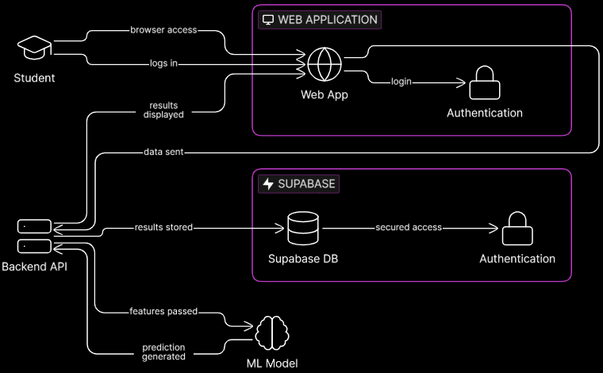
Data Flow
Student logs in
Data sent to backend
Features passed to ML model
Prediction generated
Results stored & displayed

Slide 7
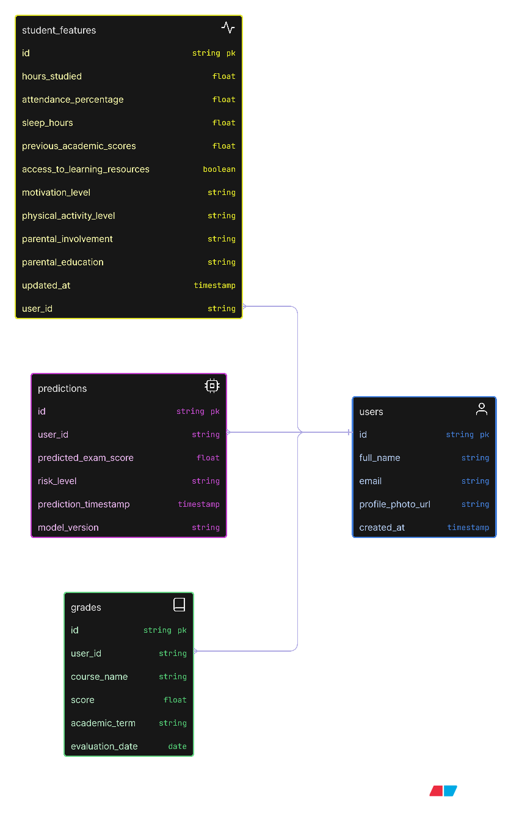
Database Design
Users
Student_Features
Predictions
Grades
The system uses a centralized relational database managed by Supabase to store user information, academic features, machine learning predictions, and course grades.

Slide 8
Machine Learning Models
Models Evaluated
Linear Regression
Random Forest Regressor
Artificial Neural Network (ANN)
Evaluation Metrics
R²
RMSE
MAE

Slide 9
Model Selection
Why Linear Regression
Strong predictive performance
Stable on unseen data
High interpretability
Suitable for explainable education systems

Slide 10
Risk Classification & Explainability
Prediction Interpretation - Risk Levels:
High Performer (≥ 75)
Medium Risk (60–74)
At Risk (< 60)
Explainability
SHAP explains feature impact
Transparent predictions

Slide 11
Web Application Features
Student Dashboard Features
Performance dashboard
Task & study management
Grades tracking
Feature contribution analysis
Peer comparison

Slide 12
Conclusion
Early detection of academic risk
Explainable machine learning predictions
Data-driven student support
Scalable and practical solution

Slide 13
Thanks!
Do you have any questions?
| Amr Khalid
| Hossam Hussein
| Shimaa Eid
| Seham Sayed

